Slide 1
The Anatomy of a Web Page
Tutorial #1

Slide 2
OBJECTIVE

Slide 3
Objective
This tutorial demonstrates how to write a standard HTML template file.

Slide 4
TEXTPLANATION

Slide 5
Textplanation
Way back in the dark times, when the digital universe was akin to a world covered in primordial goo, there was still a structure to the bits and bytes that made up the code that made up the programs that people ran. Though each language has its own structure, each language has a structure. When the World Wide Web was birthed, however, structure was the furthest thing from the minds of the code monkeys who sank their dirty paws into it. As the web has become the primary source of information for much of the world, more evolved monkeys have stepped in and standardized the structure so that new, little monkeys like us could play safely.

Slide 6
Textplanation
The interesting thing about the structure of web programming is that, like the Pirate Code, it’s more of a guideline than a rule. Since large companies have been investing millions of dollars into their web presence for years, the browsers that run our internet pages have to be able to sift through the messy script written by ancient monkeys as well as the clean stuff that you will create. So you can play safely just as long as you don't step off the narrow beam of code suspended ninety six stories above the chaos.

Slide 7
CONSTRUCTION

Slide 8
Construction
Let’s build a template and study its components as we do so.

Slide 9
Construction
Create a folder somewhere on your drive and label it First HTML.
Open up notepad++.
Save the empty file to your folder and name the file “index.html”.
All first pages on a website are called index.
As you go through the images of the construction, add to your code. You will see comments with explanations of what you are doing. Those comments will change with each slide. You should not type my comments into your code.

Slide 10
Construction
This template is the foundation for every web page we will create (you know, give or take a few exceptions) so make sure you pay attention to what you're doing.

Slide 11
Construction
Really.

Slide 12
Construction
Pay attention.

Slide 13

Construction

Slide 14
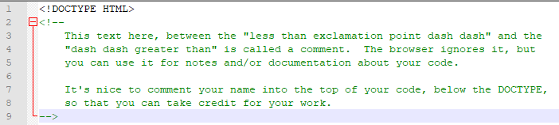
Construction

Slide 15
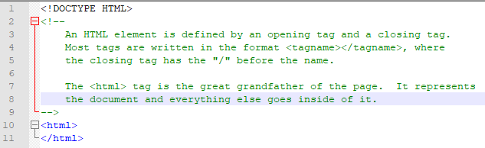
Construction

Slide 16
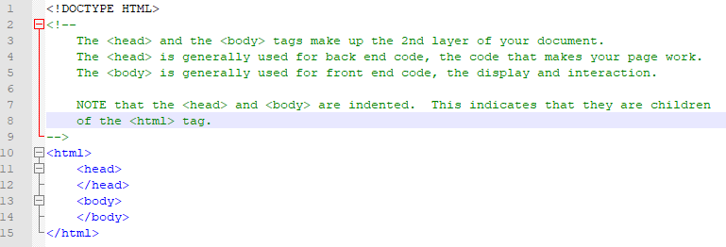
Construction

Slide 17
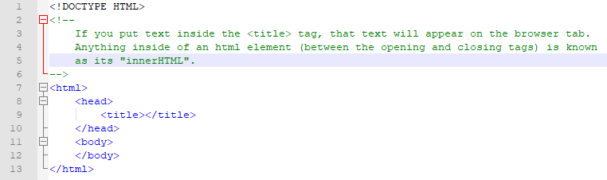
Construction

Slide 18
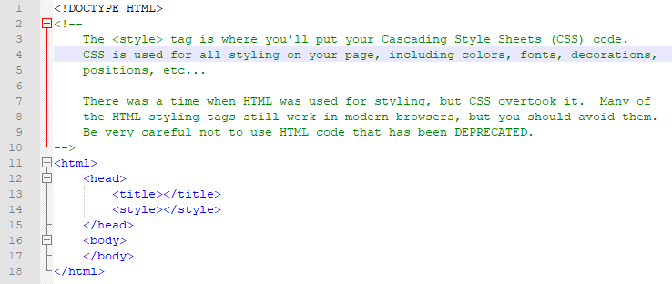
Construction

Slide 19
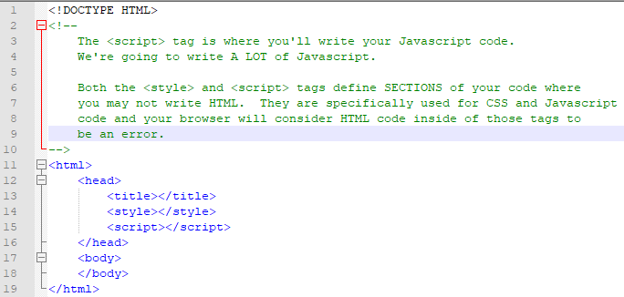
Construction

Slide 20
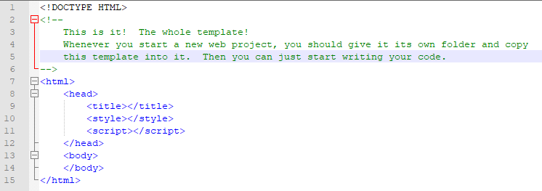
Construction

Slide 21
A DEEPER MEANING

Slide 22
A Deeper Meaning
You're probably asking yourself how this simple thing that we made can possibly create the magic that you've seen on your computer screen at home. Well, it can't. This is just the starting point. In order to transform this into that, we'll need to work with Cascading Style Sheets (CSS) and, most importantly, Javascript.

Slide 23
A Deeper Meaning
Remember those ancient monkeys? They built a structure into web pages called the Document Object Model. Your page is the document. Everything on your page is an object (actually, your document is an object also). Just like a bucket of Legos, we can pick up the objects and put them down wherever else we want. We can use them to build bigger objects. We can transform them so that they can look and behave however we want. You can't do that with Legos.

Slide 24
A Deeper Meaning
The model is dependent on you, the monkey, I mean programmer, understanding that everything on your page is an object and each object represents a piece of your page.
The <html> tag is an object. It represents the document.
The <head> tag is an object. It represents the page’s brain, where all of functional code goes.
The <body> tag is an object. It represents the page’s front end. That's where you put all of your text and information.

Slide 25
A Deeper Meaning
Can you put things in different places? Absolutely. You can definitely go all mad scientist on your page, but I recommend against it. Experimentation is good, but remember that the structure is there to keep monkey brains from melting.

Slide 26
FAQ

Slide 27
FAQ
Is the browser a compiler?
No. The browser is an interpreter.

Slide 28
FAQ
What’s the difference between a compiler and an interpreter?
A compiler is used for application languages, like Java or C++ or C#. A compiler reads your code and, if there are no errors, turns it into machine code so that it can be executed on a computer. If there are errors, it will alert you so that you can fix them. An interpreter starts at the top of your code and executes each line as it reads it. If there are errors in your code it will ignore them unless they are so severe that they prevent the program from continuing. Then it just crashes.

Slide 29
FAQ
Is HTML case sensitive?
HTML is not case sensitive, however modern standards expect that all HTML code is written in lowercase letters.

Slide 30
FAQ
What does deprecated mean?
Code that has been deprecated is code that has been rendered obsolete. Though many browsers will still recognize deprecated code for backwards compatibility, you should always avoid it.

Slide 31
FAQ
How can I recognize whether or not internet coding examples are outdated?
Check the dates. If you find code online that is more than 5 years old, you shouldn’t use it directly. It may give you great ideas on how to solve problems, but make sure you understand it and can rewrite it in a modern style. Also, avoid HTML examples that are written in ALL CAPS. Old HTML programmers used capital letters, but the standard now says to use all lowercase.

Slide 32
ACTIVITY

Slide 33
Hello World
Create a new folder for this activity and copy (don’t move) your index into it. Open the new index in Notepad++ or whatever editor you’re using.
Type Hello World into the body of your page.
Type My First Page into the <title> tag.
You can run your page from your editor. You can also run it by finding it in its saved folder and double clicking the icon. Whenever you make changes to the code, you must refresh your page (F5 or click the icon) to see the changes.
Make some changes.

